Slide 1
Bacteria-Surface Interaction Simulation

Slide 2

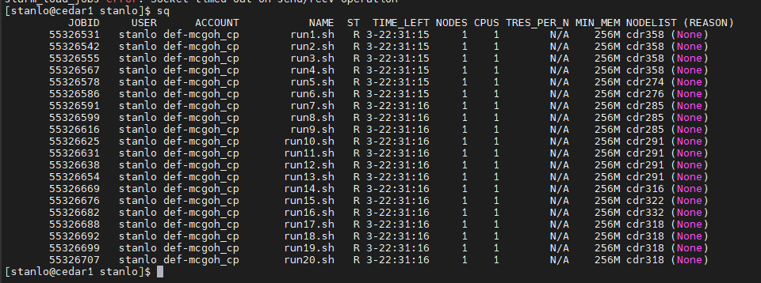
Compute Canada
My simulations take a long time (8-10hrs / run)
Resources: Lab Computer, and now Compute Canada
Access to GPUs and CPUs! Let me know if you guys would ever want this.
They’re funded by Canada Foundation for Innovation to support Canadian researchers

Slide 3
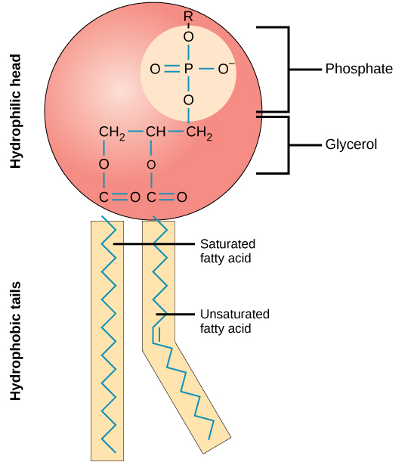
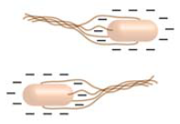
Background
Motivation
Challenging the pre-concepted notion of macroscopic properties governing the outcome
Context
Net negative bacteria¹ binds to positive surface. (phospholipid bilayer)
But what if we introduce domains such as glycoproteins, channel proteins, etc?
How will different sizes of positive domains on a net negative bacteria bind to a surface with a gradient from negative to positive?
1. Tuson, H. H.; Weibel, D. B. Bacteria–surface interactions. https://pubs.rsc.org/en/content/articlelanding/2013/sm/c3sm27705d (accessed Dec 1, 2020).

Slide 4
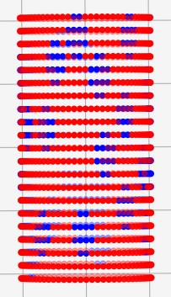
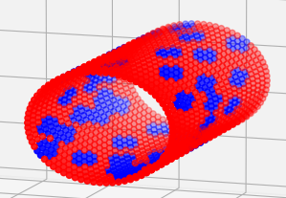
Technicals
Bacteria Composition/Characteristics
Net negative surface charge (70%)
Positive domains scattered randomly (30%), with no overlapping domains
Total number of points: 1512
Number of circles = 21, Number of points per circle = 72
Length - 2µm, Diameter - 1µm
Shape: Cylinder
Resolution: 962.6pts/µm²

Slide 5
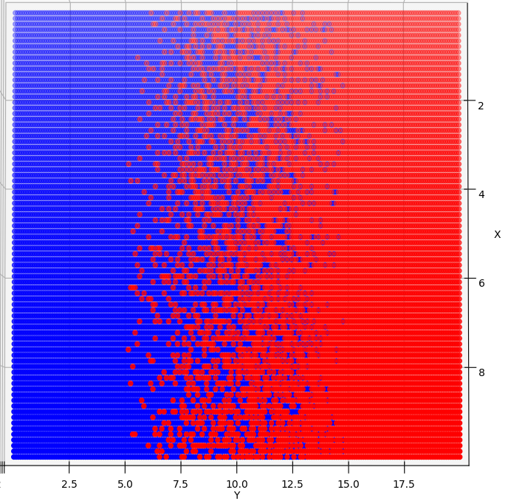
Technicals
(+)
(-)
Surface Composition
Gradient
Size: 20 (L) x 10 (W) µm
Effective Size: 10 (L) x 10 (W) µm
Resolution: 200 (L) x 80 (W) = 16000 pts
Effective Resolution: 100 (L) x 80 (W) = 8000pts (80pts/µm²)

Slide 6
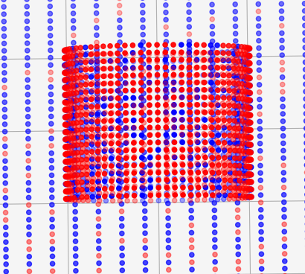
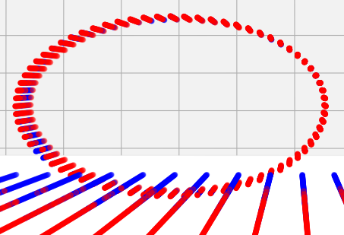
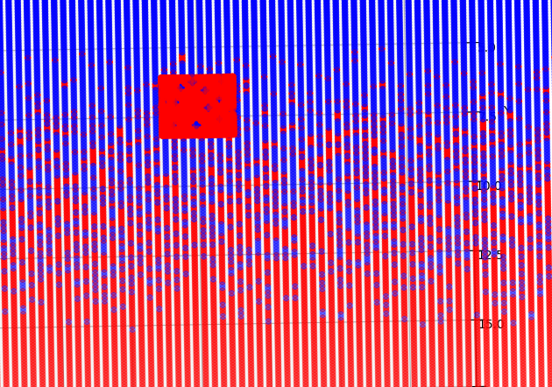


The Process
1st
2nd
3rd
4th
5th
Translate
X-axis: Increments of 0.2µm
Y-axis: Increments of 0.25µm
Rotate XY (z-axis)
9º per rotation (360º /40 rotations )
Rotate along cylinder axis
72 rotations (around each dot on the circle) which is 5º per rotation
Evaluate Energy
Search angle is 75º
Distance is calculated to closest point
Log Results
1 Interaction per point on bacteria
75

Slide 7
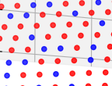



EXPERIMENTS
150* seeds/samples
4 domain sizes
per domain size
single (1pt)
diamond (5pt)
small (12pt)
large (37pt)

Slide 8
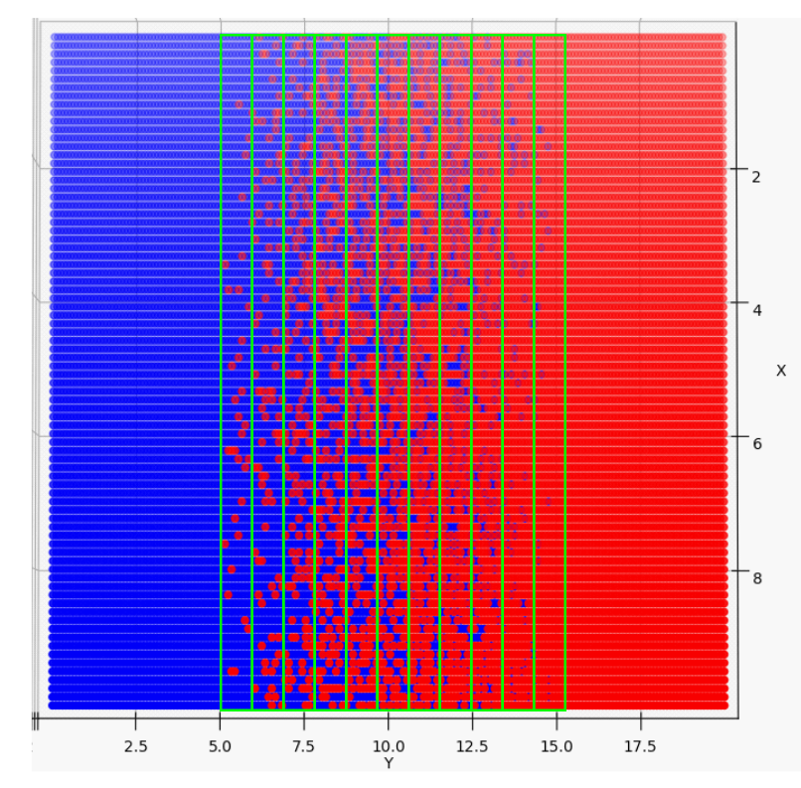
What is 1 Datapoint? + Controls
Technical
If the center of the cylinder lands within the boundaries of a 5% strip (ex. 10-15% increases in frequency by 1)
IV → Domain Size
Controls
Number of interactions per gradient strip: 1318
Size, Surveyed Area, Process of Interaction

Slide 9
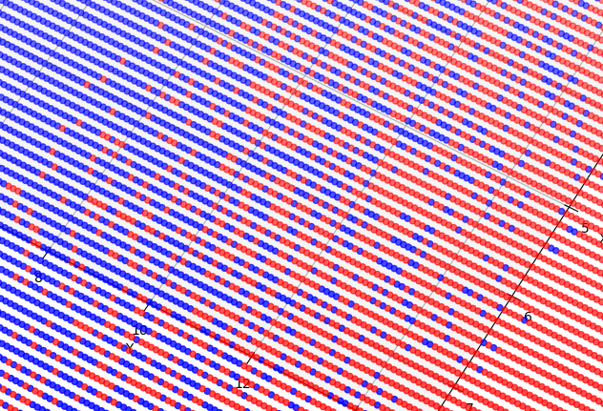
Results – Gradient Strip Frequency
Graphs
 | Weighted Average (% Negative)
Single | 31.5%
Diamond | 27.5%
Small | 26%
Large | 22%

Slide 10
Results – Gradient Strip Frequency
Graphs

Slide 11
Results – Surface Charge
Calculated by taking the points on the surface underneath the bacteria’s search angle, and summing the charges
 | Single | Diamond | Small | Large
Avg. Surface Charge (150 samples) | +78.8 | +83.4 | +83.9 | +88
Total number of interacting points on surface: approx. 105-115 pts

Slide 12
Conclusion
Concentration is the same throughout (70% negative, 30% positive)
BUT domain size causes bacteria to land on different areas on the surface
Macroscopic View → Bacteria lands on most positive surface
Microscopic View → Bacteria can land on surface with less positive charges
Results challenge macroscopic view with a microscopic property
(+)
(-)

Slide 13
Future Work
Change the surface rather than the bacteria?
Writing a paper.
Intuitive format to present data and experimental methods
Physical Experiments
Showing that two different bacteria will bind to different parts on a gradient surface.
Run more simulations! (>250/domain size)
What’s an appropriate number of simulations?

Slide 14
Thanks!
Any questions?

